Slide 1

Data-Driven Approach to Air Quality Predictions in Major Cities
Team Insight
Bhaskar Dhariyal, Ashish Singh, Uche Mbake, Thach Le Nguyen, Qinqin Wang, Bahavathy Kathirgamanathan
Notes:
Good evening,
- Today I am going to present to you an idea for a data driven approach to making air quality prediction in major cities. My team mates are Bhaskar, Ashish, Uch, Thach, Qinqin and myself.

Slide 2

Air pollution is one of the greatest environmental risks to health… [1]
…In 2019, 99% of the world’s population was living in places where the WHO air quality guidelines levels were not met… [1]
…Two of the most dangerous pollutants are nitrogen dioxide (NO₂) from vehicles and particulate matter (PM2.5) from vehicles, wood burning, industry and farming [2]
[1] https://www.who.int/news-room/fact-sheets/detail/ambient-(outdoor)-air-quality-and-health
[2] https://www.blf.org.uk/taskforce/data-tracker/air-quality/pm25
Notes:
Before I present our idea, why should we even care?
Well, air pollution is one of the greatest environmental risks to health and in 2019, 99% of the world’s population was living in places where the WHO recommended air quality guidelines were not met.
Of these pollutants, two of the most dangerous pollutants are NO2 and PM2.5 which comes from sources such as vehicles, wood burning, industry and farming.

Slide 3

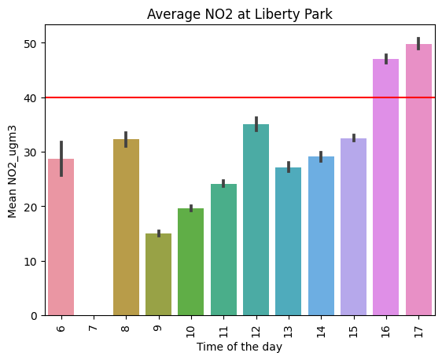

What can impact air quality at a given location?
Weather
Air temperature affects movement of air
Wind can transport pollution
So weather could be an indicator for air pollution [3]
Time of the Day
Lunch times + Evenings = Greater PM2.5 and NO₂ levels.
[3] https://scied.ucar.edu/learning-zone/air-quality/how-weather-affects-air-quality
Notes:
When we look into this even further, we found that weather could have a big impact on the air quality. For example the air temperature affects the way air moves and on windy days, pollution can be carried to other parts of the city. We also saw that when we focused on the air quality over time in vertain locations, we saw that the time of the day had a big influence. For example we saw higher mean NO2 level during lunch times and in the evening in Parks around Dublin as we can see in the example we have on liberty park.
Strong correlation between weather patterns and air quality

Slide 4
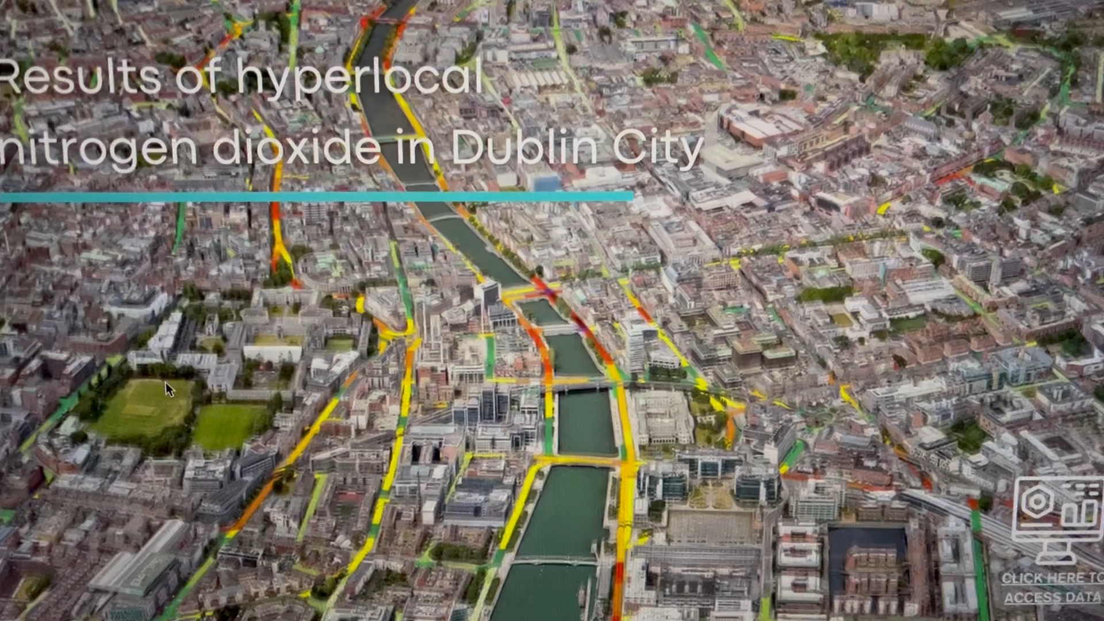



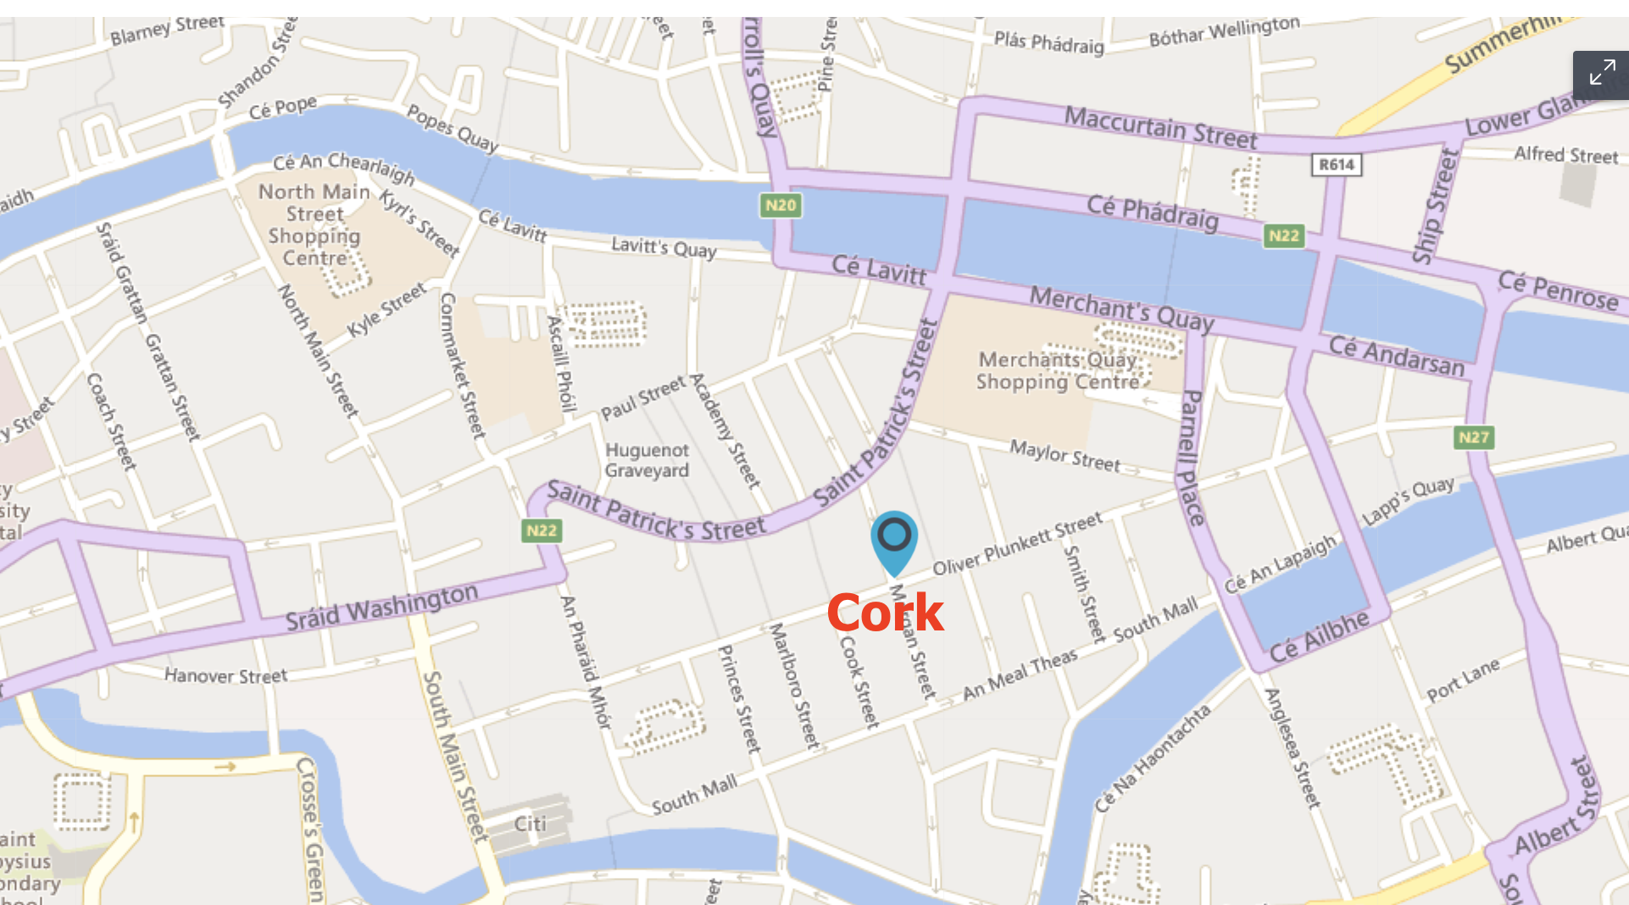

Our Proposed Solution
Predict: PM2.5 and NO2
Validate on Ground Truth data from Dublin
Test on Other Major Cities
AI
Notes:
Knowing that weather and time could be important features, we built a predictive model where we used weather and time info as features into a machine learning model to predict the PM2.5 and NO2 levels. We also recognise that traffic volume could provide important features which we plan to implement in the future. Using this we can use the ground truth data from Dublin to validate our model and we can then use this model to test on any other major city.

Slide 5
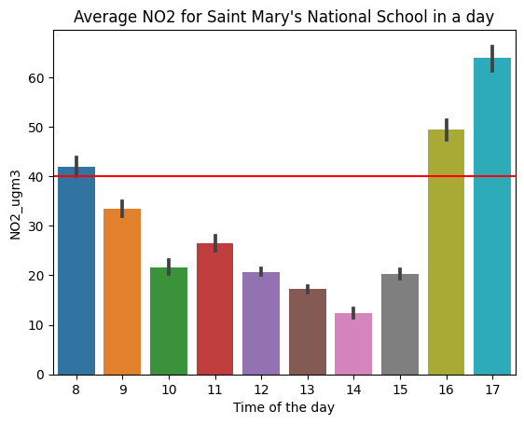
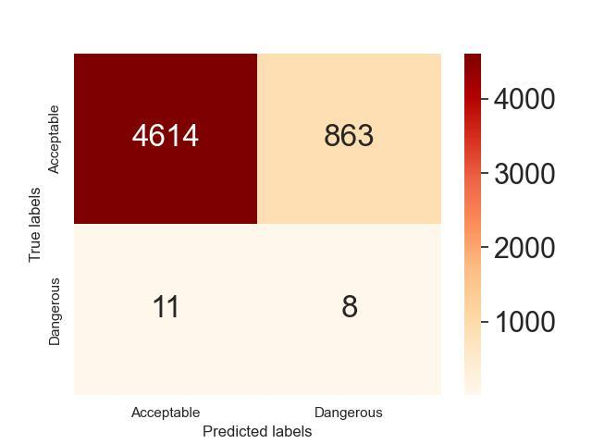
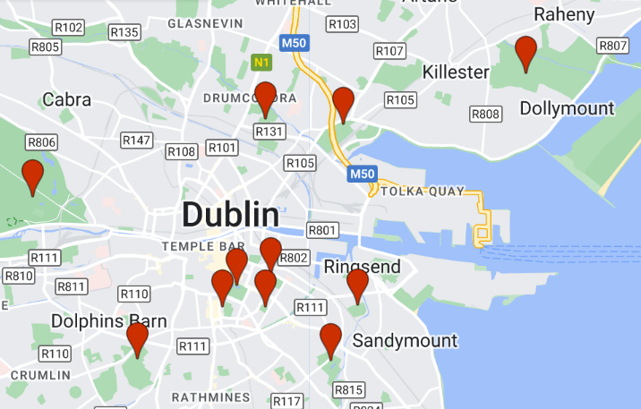
Our Results
Mapped open source weather and location data with provided latitude and longitudes
Current best accuracy = 84 %
https://dev.meteostat.net/python/
Notes:
Divided data into acceptable/non acceptable based on
Mapped open source weather data with the latitude and longitude that was provided.

Slide 6

Questions??
Future Work
Include traffic volume as a feature
More model validation
Use model to make prediction in other cities

